Slide 1

ALY 6980 Capstone:
Final Presentation
Authored By:
Abhigna Ramamurthy
Charu Priya Singh
Jesseka Shah
Karolina Grodzinska
Submitted to: Prof Roy Wada

Slide 2

Introduction
Our project was based on the data from Free Float Media about almost 73K directors and 9.5K companies
Business questions:
Does gender play a role in the composition of the board?
What kind of people become directors?
What kind of directors become influential?
What are the characteristics of directors/boards that perform well in terms of carbon intensity?

Slide 3
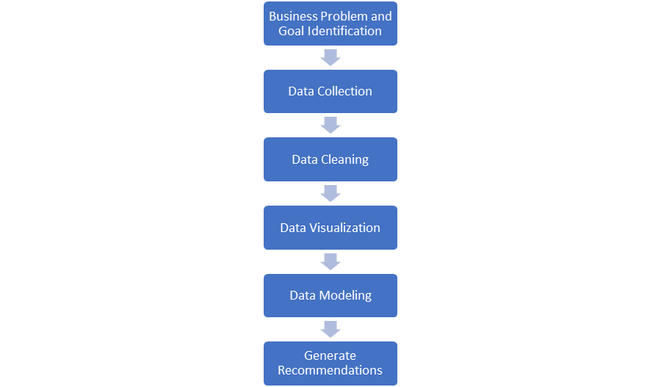
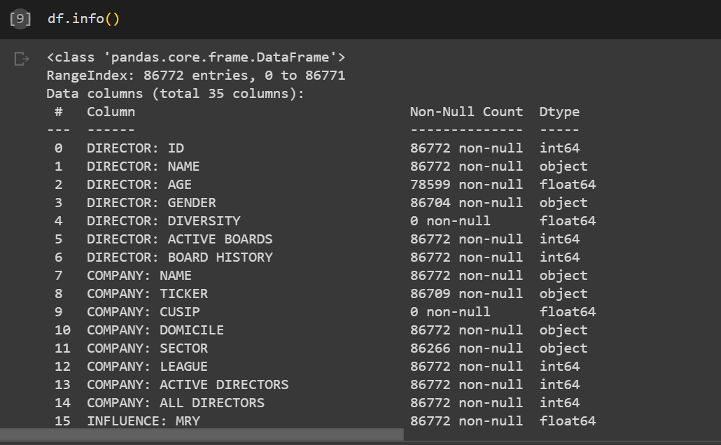
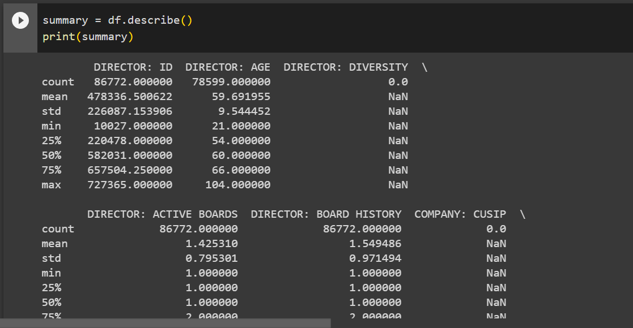

Slide 4
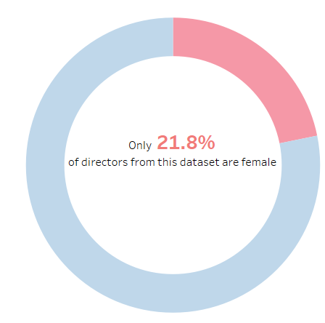
Exploratory Data Analysis
This proportion is even smaller for "influencers", where only 13.4% of influencers from this dataset are female

Slide 5
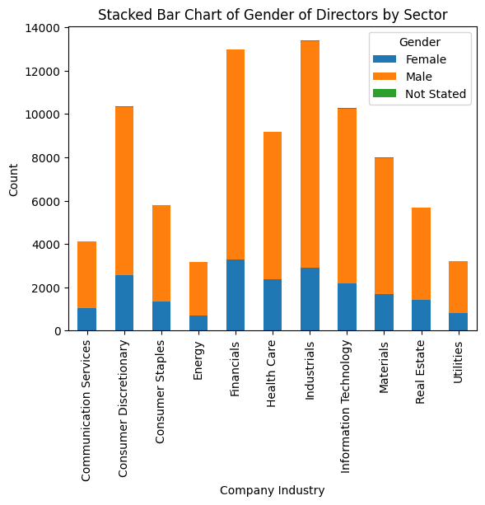
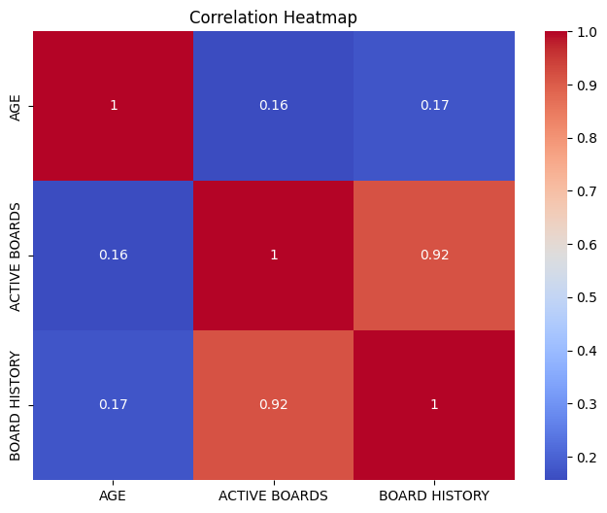
Figure 1 indicates the distribution of gender across sectors
Figure 2 is the correlation plot of board composition

Slide 6
The relationship between gender and the characteristics of the board
The dependent variable is Gender
The independent variables are Age, Active Boards, Board History
Logistic regression with cross validation is the optimum model
Algorithm | Model Accuracy | Precision | Recall | F1 Score
Decision Tree | 78% | 74.1% | 78.8% | 72.3%
SVM | 78.6% | 61.8% | 78.6% | 69.2%
Random Forest | 78.8% | 74.16% | 78.8% | 72%
Logistic Regression | 78.3% | 63.8% | 78.3% | 69.1%

Slide 7
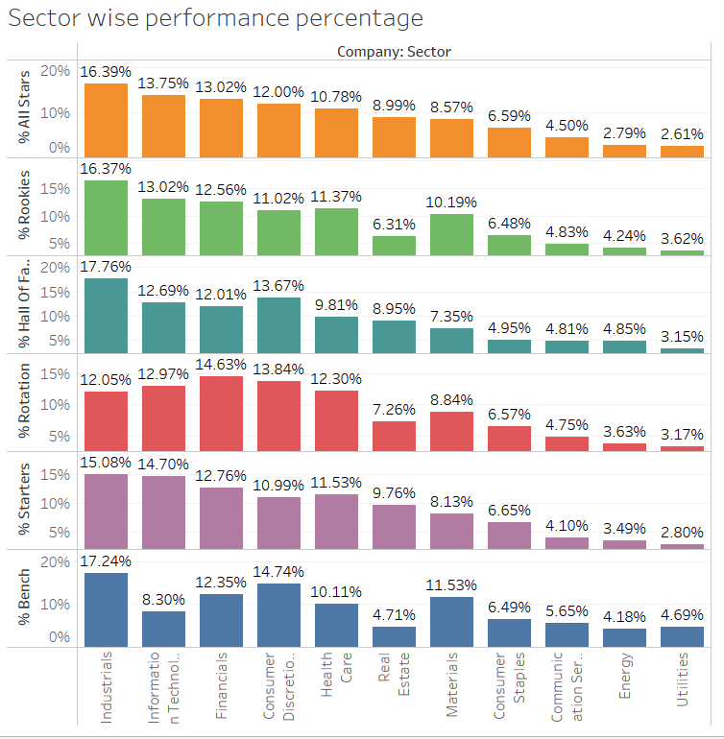
Potential of becoming the board of director
The total influence of active directors in different sector based on the titles they had held in the past.
Industrials has almost similar percentage of director from all section of performance tags. But most prominent is hall of fame holders.
However, the utilities sector has the least number of people from hall of fame.

Slide 8
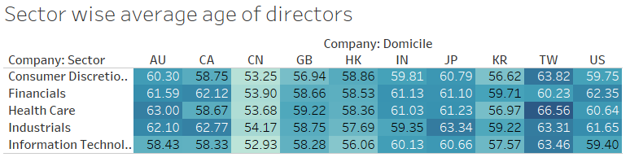
Potential for becoming director
Average age required for person in a sector to become director based on the domicile
Filtered out top 10 domicile region based on sector and the youngest age of a director is CN (China) as 53 in Information technology sector.
The potential age that is found for a person to be a director is from age 53 to 66.

Slide 9
Potential for Becoming Director
S.no​ | Algorithm | Accuracy ​ | Precision ​ | Recall ​ | F1-Score​
1​ | Logistic Regression​ | 77%​ | 78%​ | 90%​ | 84%​
2​ | Decision Tree​ | 75%​ | 78%​ | 86%​ | 82%​
3​ | SVM​ | 76%​ | 75%​ | 95%​ | 84%​
The features 'INFLUENCE DRIVER: ADVANCED DEGREE, INFLUENCE DRIVER: ELITE SCHOOL' contribute the most to the target value, which is Has_Been_CEO
Logistic Regression is the best model with 77 % accuracy but due to the class distributions are extremely skewed, accuracy might lose its usefulness as a measure of model performance
Having advance degree or elite school name is not primary factor to become a part of board of directors.
It's seen that Female with higher degree are the one making to elite position than males. But the number of Female at the top are less in number. Therefore, it is not essential to have an elite degree or education to be part of the board.

Slide 10
Decision making among the board of directors
S.no​ | Algorithm | Accuracy ​ | Precision ​ | Recall ​ | F1-Score​
1​ | Logistic Regression​ | 93%​ | 88%​ | 92%​ | 90%​
2​ | SVM | 93%​ | 87%​ | 93%​ | 89%​
3​ | KNN | 82%​ | 75%​ | 68%​ | 71%​
The features “carbon intensity win rate” and “age” contribute the most to the target value, which “Performance: Controversy win rate”
Controversy win rate helps us understand that age is an important factor in decision making of the boards.
Age brings in experience and influence on the other member adding an edge to decision making.

Slide 11
Understanding the factors affecting the influence of the directors
Contributing factors include experience that is more than 3 years of directorship and prior experience as a CEO
Greater experience translates to increased influence and decision-making power
Algorithm | Model Accuracy | Precision | Recall | MSE
Logistic Regression | 87.5% | 86.9% | 72% | 0.125
Decision Tree | 88.4% | 80.6% | 84% | 0.116
Random Forest | 87.4% | 80.7% | 80% | 0.126
KNN | 87.15% | 82% | 78% | 0.124

Slide 12
Understanding the factors affecting the total Carbon Intensity wins
Highest contributing factors include controversy win rates and quantified latest influence of the director
Influence that the board of director has over other members positively impacts the win rates
Algorithm | Model Accuracy | Precision | Recall | MSE
Logistic Regression | 77.1% | 67.7% | 97.2% | 0.229
Decision Tree | 77.2% | 67.6% | 97.7% | 0.228
Random Forest | 72% | 69.2% | 71.6% | 0.280
KNN | 73.97% | 69% | 79% | 0.282

Slide 13

Conclusion
Main business questions we have tried to answer relate to gender diversity, prior experiences, influential directors and finally leading up to understanding carbon intensity win rates.
Gender bias plays a vital role in understanding the potential of joining a board of directors.
Females are required to have more advanced and elite degree to be part of a board. However, majority of boards of directors who are male do not require it. Therefore, number shows that advance degree are not primary factor.
Controversy win rate helps us understand that age is an important factor in decision making of the boards.
Greater experience translates to increased influence and decision-making power thus higher positive impact on the carbon intensity win rates
Data Governance strategy involved data quality assessment, feature engineering, reporting and analytics solutions.

Slide 14
References
FreeFloat Media. (2023). FreeFloat Media. Retrieved from https://www.freefloatmedia.com/
Minichilli, A., Zattoni, A., & Zona, F. (2007). Making Boards Effective: An Empirical Examination of Board Task Performance. British Journal of Management, 18(3), 171-187. https://onlinelibrary.wiley.com/doi/full/10.1111/j.1467-8551.2008.00591.x?saml_referrer
Zahra, S. A., & Pearce, J. A. (1989). Boards of Directors and Corporate Financial Performance: A Review and Integrative Model. Journal of Management, 15(2), 291-334. https://journals.sagepub.com/doi/epdf/10.1177/014920638901500208
Tuggle, C. S., Sirmon, D. G., Reutzel, C. R., & Bierman, L. (2012). Commanding board of director attention: investigating how organizational performance and CEO duality affect board members' attention to monitoring. Journal of Management Studies, 49(7), 1197-1222. https://onlinelibrary.wiley.com/doi/full/10.1002/smj.847?saml_referrer

Slide 15


Thank You

